Slide 1

Heart Disease Prediction Using Machine Learning
A comparative study evaluating four ML models for heart disease prediction.
2024801015 - Mantasha Mohammed Sadiq CSE DIV A Batch A

Slide 2

Study Overview and Dataset
Dataset
Goal
1025 patient records with 14 clinical features.
Compare Logistic Regression, SVM, KNN, and Random Forest models.
Target
Predict presence or absence of heart disease.

Slide 3

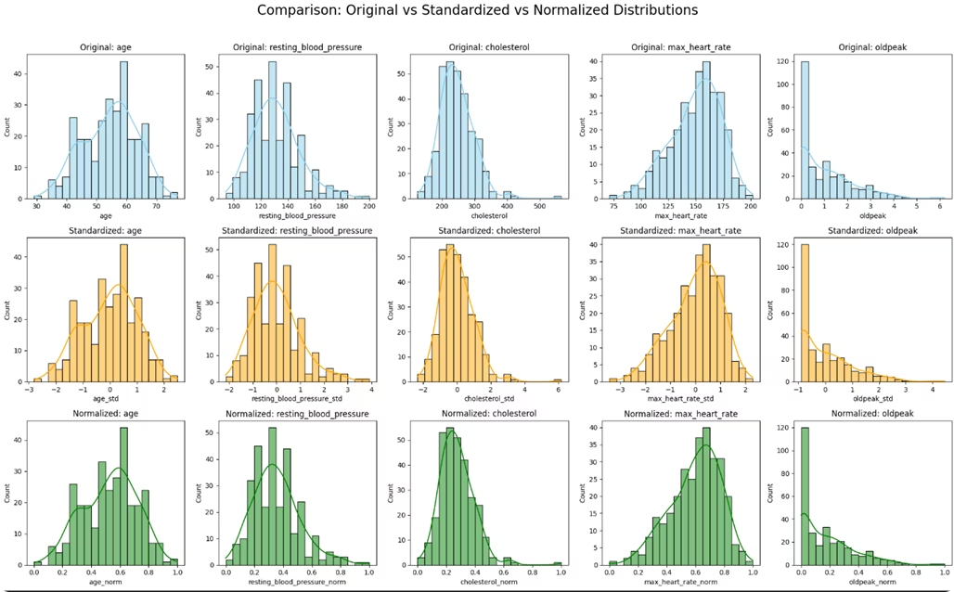


Data Preprocessing and Feature Engineering
Preprocessing
Convert categorical data, handle missing values, standardize features.
Key Features
Age, sex, chest pain, blood pressure, cholesterol, ECG results, and more.

Slide 4
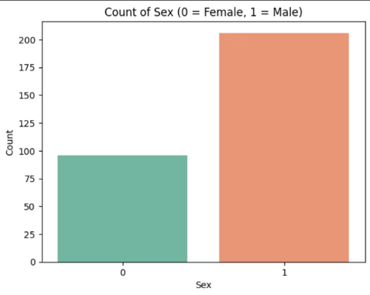
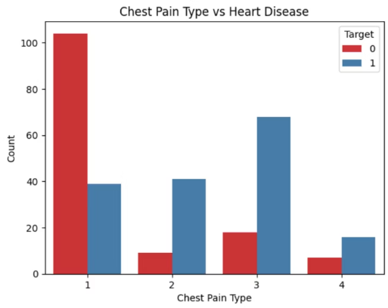
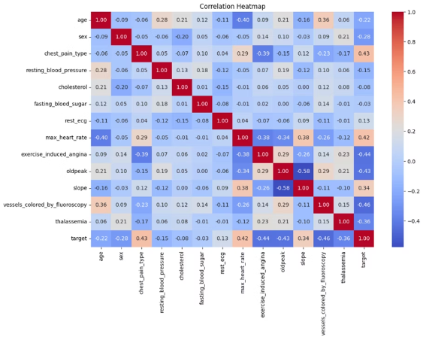
Exploratory Data Analysis (EDA)
Key Statistics
Insights
Mean Age: 54.4 years
Male dominant dataset (68.2%)
Mean Cholesterol: 246.5 mg/dL
Chest pain type strongly differentiates disease presence
Mean Max Heart Rate: 149 bpm
Correlations: Chest pain (0.43), Max heart rate (0.42)

Slide 5
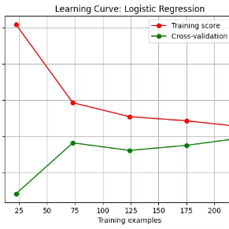
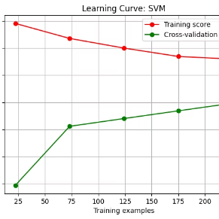
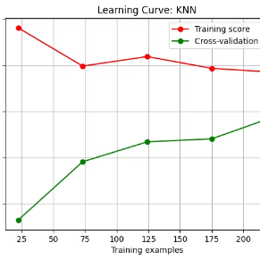
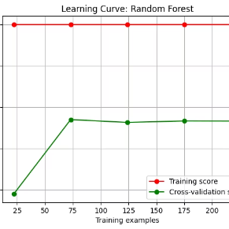
Machine Learning Models Used
Logistic Regression
Support Vector Machine
K-Nearest Neighbors
Random Forest
Ensemble of decision trees voting for class prediction.
Linear model estimating heart disease probability.
Finds optimal hyperplane to separate classes.
Classifies based on nearest neighbors in feature space.

Slide 6

Model Evaluation Metrics
Metrics Used
Accuracy
Precision
Recall
F1 Score
ROC AUC
Workflow
Data cleaning → Feature engineering → Train-test split → Model training → Evaluation

Slide 7

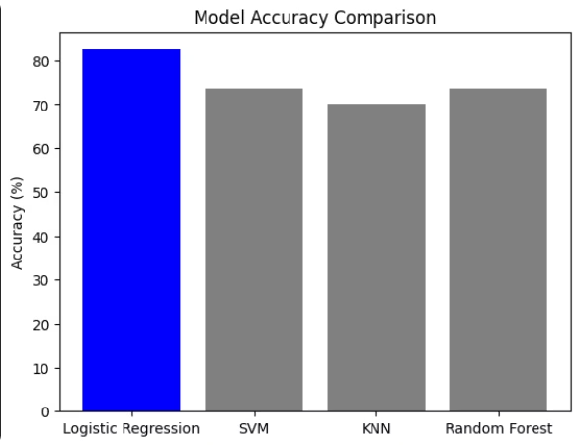
Performance Comparison
Model
Accuracy
F1 Score
Logistic Regression
82.46%
84.38%
Random Forest
73.68%
75.41%
Support Vector Machine
73.68%
74.58%
K-Nearest Neighbors
70.18%
70.18%

Slide 8




Analysis of Results
Logistic Regression
Highest accuracy, effective linear relationship capture.
Random Forest & SVM
Moderate accuracy with different precision-recall trade-offs.
KNN
Lowest performance, less effective for this dataset.

Slide 9
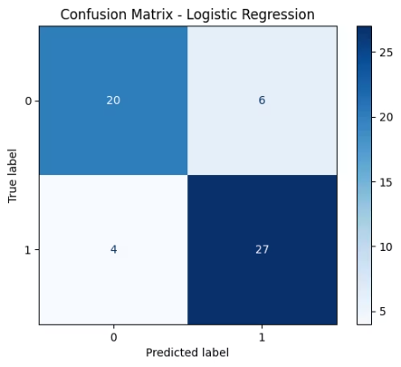
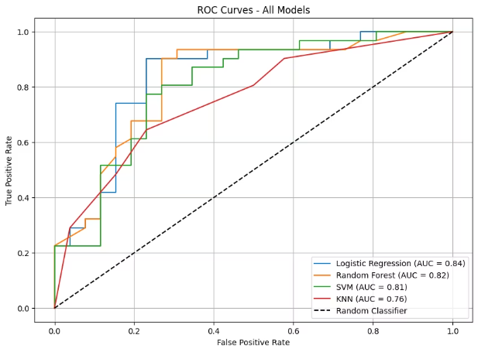
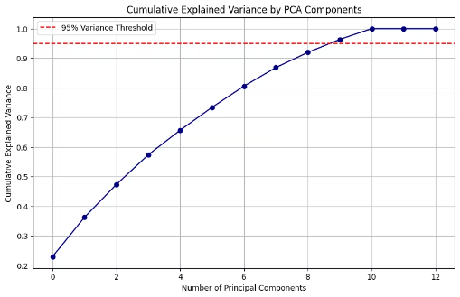
Project Screenshots
Confusion Matrix
Model Performance
PCA visual
Confusion matrix for logistic regression
Visuals of accuracy, F1 scores, and ROC curves for quick evaluation.
Plot explained variance by each component.

Slide 10




Conclusion and Future Work
Conclusion
Future Directions
Logistic Regression outperforms complex models for heart disease prediction.
Explore feature importance, larger datasets, and temporal data integration.
Impact
Supports development of ML-based clinical decision support for early detection.

